Slide 1
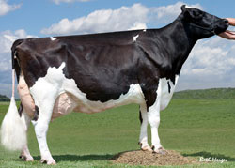
USDA-ARS Research Portfolio and Perspectives for Dairy Cattle Breeding
AGIL
Dr. Erin E. Connor, Research Leader
Animal Genomics and Improvement Laboratory
(301) 504-6104
erin.connor@ars.usda.gov
CDCB Workshop, September 29, 2015, Madison, WI

Slide 2
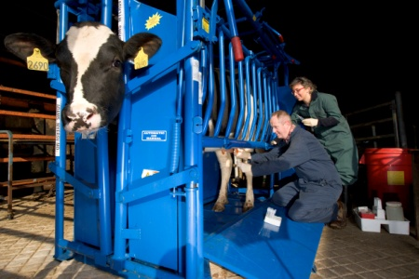
Dairy Cattle Research at USDA-ARS
2 National Programs of Primary Importance:
Food Animal Production
Animal Health
Program Goals:
Food Animal Production: abundant and affordable animal products , domestic food security, and environmental sustainability
Animal Health: prevent and control animal diseases impacting agriculture and public health

Slide 3
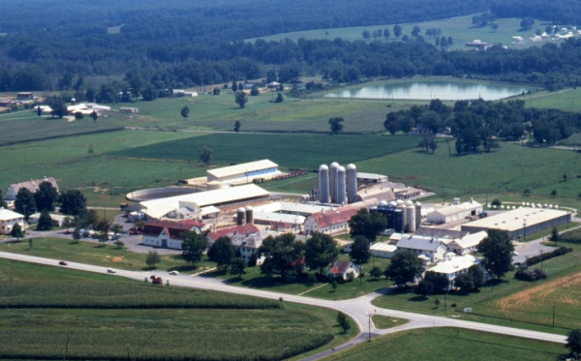
Appropriated Dairy-Related Research
Food Animal Production – 10 Projects
ARS Location | Research Focus
Fort Collins, CO | Germplasm preservation
Beltsville, MD | Genetic prediction and improvement of dairy cattle
 | Genomic selection of ruminants
 | Dairy cattle feed efficiency
West Lafayette, IN | Animal well-being
Stoneville, MS | Biophotonics
University Park, PA | Pasture-based dairy production
Madison, WI | Dairy forage and manure management
 | Forages on dairy feed efficiency and environment
 | Microbes, feed, and animal factors on dairy feed efficiency
*Red indicates genetics/breeding approaches

Slide 4
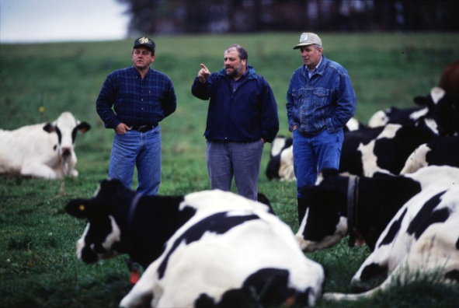
Appropriated Dairy-Related Research
Animal Health – up to 16 Projects
ARS Location | Research Focus
Ames, IA | Mastitis
 | Johne's disease
 | Tuberculosis
 | Bovine respiratory disease complex
 | Viral diseases of cattle
 | Spirochetes
 | Brucellosis
Beltsville, MD | Gastrointestinal nematode resistance (ruminant hosts; parasites)
Clay Center, NE | Genetics of ruminant respiratory diseases (primarily beef/sheep)
*Red indicates dairy genetics/breeding approaches

Slide 5
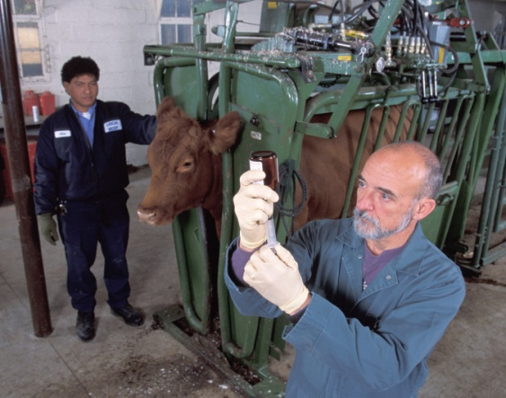
Appropriated Dairy-Related Research
Animal Health – up to 16 Projects (cont’d)
ARS Location | Research Focus
Pullman, WA | Anaplasmosis
 | Babesiosis
Orient Point, NY | Foot and mouth disease
Manhattan, KS | Rift Valley fever
 | Emerging vector-borne viruses
Albany, CA | Prion disease diagnostics

Slide 6
Key Points - 1
Many ARS projects address dairy cattle production issues affecting the industry
Projects using genetics/genomics and breeding are limited, but opportunities for expansion and collaboration exist
Beltsville, MD location (AGIL) principal federal dairy cattle genetics location – how do we sustain/grow?

Slide 7
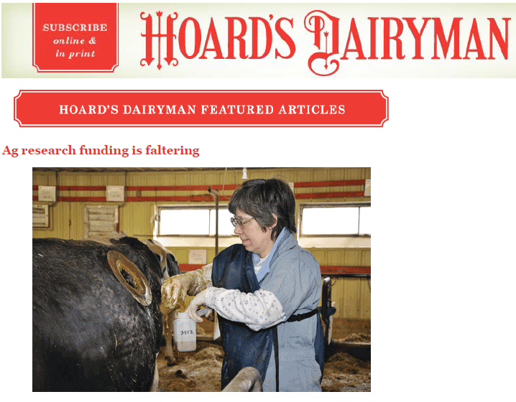
Page 567 of September 10, 2012 Issue
Industry input needed to prioritize research efforts!

Slide 8
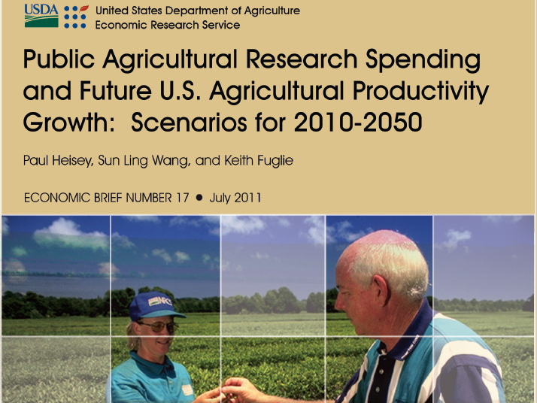
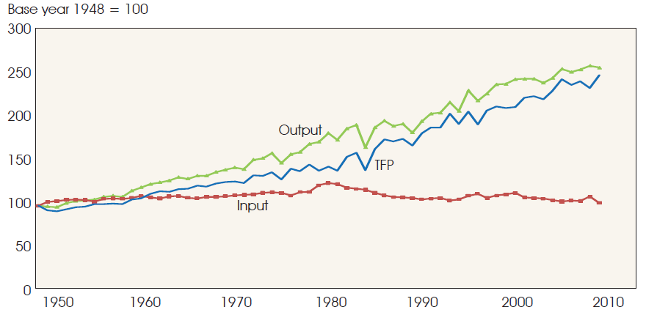
U.S. Agricultural Production
1.58%
2.5-fold increase since 1948
1.52%
Rate of Technological Change
Total Factor Productivity
Modified From Heisey, P., S.L. Wang, K. Fuglie. USDA Economic Research Service, July 2011.

Slide 9
Public Agricultural R&D Spending
Needs through 2050
The U.S. must increase agriculture output by 70-100% by 2050.
Public agricultural R&D drives private R&D, adoption of new technologies, and output growth.
Output growth increased ~1.5%/year over the last 50 years.
Same public R&D spending = 0.75% growth/year and output increases 40% by 2050.
3.73% annual increase in public R&D spending (offsetting inflation) = output increases 75% by 2050.
4.73% annual increase in public R&D spending = output increases 83% by 2050.
Conclusions from Heisey, P., S.L. Wang, K. Fuglie. USDA Economic Research Service, July 2011.

Slide 10
USDA-ARS 20-Year Spending History
Millions
Source: NSF.gov – Federal Funds for Research and Development: Fiscal Years 2013-15

Slide 11
Animal Genomics and
Improvement Laboratory
Mission: To improve health and production efficiency of dairy cattle and small ruminants through genetic evaluation, selection, and genomics
4 Research Projects ($8.2M appropriated):
Genomics of Feed Efficiency in Dairy Cattle
Genetic Prediction and Improvement of Dairy Cattle
Genomic Selection of Ruminants
Genomics of Ruminant Resistance to Gut Nematodes
Permanent staff of 12.1 Scientists and 23.6 Support Staff

Slide 12
AGIL Project Structure
Genomic
Selection
Gut Parasite
Resistance
2 Res. Geneticists (VanTassell;
Vacant)
Res. Biologist (Liu)
Comp. Biologist
(Schroeder)
Mol. Biologist
(R. Li)
Res. Geneticist (Bickhart)
Feed Efficiency
Res. Geneticist (Van Raden)
2 Res. Geneticists
(Cole; Wiggans)
Mol. Biologist (Connor)
Animal Scientist (Baldwin)
Cell /Mol. Biologist (C. Li)
Stat. Geneticist
(O’Connell)
Univ. Maryland
Genetic Prediction and Improvement
Animal Scientist
(Elsasser)
USDA-ARS

Slide 13
AGIL Strategic Partnerships
Feed Efficiency Project
Michigan State University – alternative models to estimate feed efficiency of dairy cows for genetic selection
University of Connecticut – new algorithms for GWAS of feed efficiency of dairy cows
University of Maryland – models to estimate individual cow feed intake from DHI measures
Universities of Guelph and Alberta – GEBV for feed efficiency and methane emissions in dairy cattle

Slide 14
AGIL Strategic Partnerships
Genomic Selection Project
Department of Environment and Primary Industries, Australia Whole-genome sequencing data from ~2,000 internationally renowned bulls ($3.4M value) on behalf of 1,000 Bulls Consortium
- development of superior SNP chips
- genome structural variant discovery

Slide 15
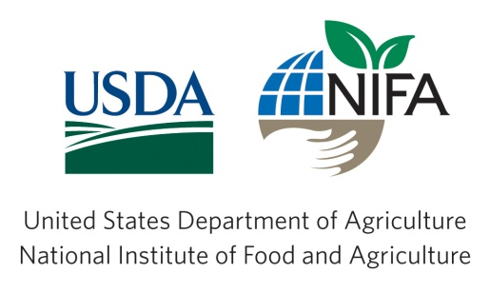
AGIL External Funding
$1.27M from 4/2012 to 7/2015 ≈ $391,000/year
supporting genetics and breeding research
Sources:
National Institute of Food & Agriculture (NIFA)
Private Organizations
University Foundations
Binational Agricultural Research
& Development Fund (BARD)

Slide 16
Key Points - 2
Challenges to dairy genetics and breeding research
Funding limitations – prioritize efforts!
Loss of personnel/expertise
Leadership changes within Agency
Strategies to remain leaders
Efficient use of expertise/personnel
Train and recruit new scientist positions
Strategic partnerships
External funding
Educate leadership of needs and priorities

Slide 17
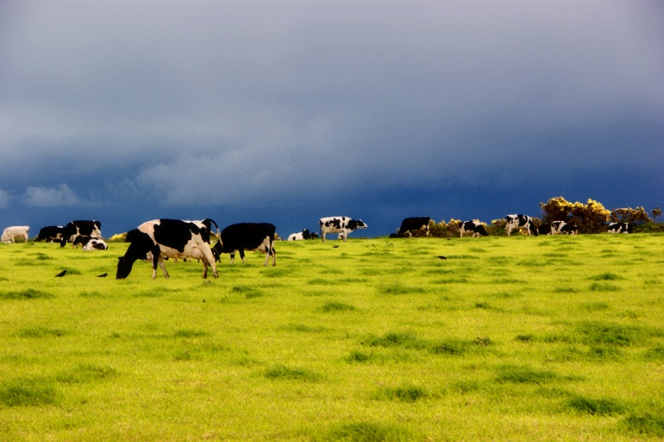
Thank you

